Slide 1


CHAPTER 2:
Introduction to React& JSX

Slide 2

Outline
WEB DEVELOPMENT
ENVIRONMENT SETUP & INSTALLATION GUIDE
NODE AND PACKAGE MANAGER (NPM)
DEPENDENCY
SETTING UP A REACT PROJECT
REACT PROJECT FOLDER STRUCTURE
INTRO TO JSX
DYNAMIC VALUES & LISTS IN JSX
CONDITIONALS IN JSX
REACT PROPS

Slide 3
Web Development
Web development refers to the building, creating, and maintaining of websites.
A website is a collection of web pages and related content that is identified by a common domain name and published on at least one web server.

Slide 4
Web Development
A web server accepts and fulfills requests from clients for static content (i.e., HTML pages, files, images, and videos) from a website.
Web servers handle HTTP requests and responses only.

Slide 5
Web Development
Web Development can be classified into two ways:
Frontend Development.
Backend Development.

Slide 6
Frontend Development (Client-Side)
Frontend is the part of a website that users see and interact with directly in the browser.
It focuses on:
UI (User Interface)
Layout & Design
User interactions
Responsiveness.
Popular Frontend Frameworks & Libraries:
Angular , React , Vue.js , jQuery, Bootstrap, Material UI, Tailwind CSS.

Slide 7
Backend Development
Backend is the server side of a website.
It is the part of the website that users cannot see and interact.
It handles:
Databases
Authentication
Business logic
Server communication.

Slide 8
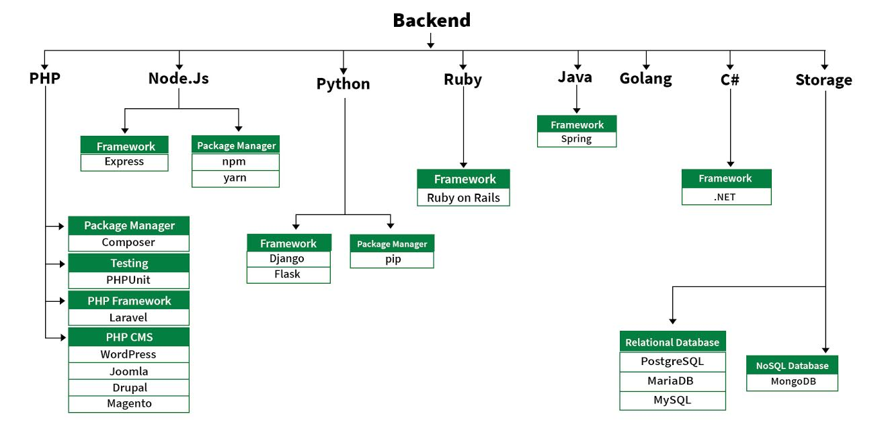
Web Development
https://www.geeksforgeeks.org/web-development/
Notes:
PHP: PHP is a server-side scripting language designed specifically for web development.
Java: Java is one of the most popular and widely used programming language. It is highly scalable.
Python: Python is a programming language that lets you work quickly and integrate systems more efficiently.
Node.js: Node.js is an open source and cross-platform runtime environment for executing JavaScript code outside a browser.
Back End Frameworks: The list of back end frameworks are: Express, Django, Rails, Laravel, Spring, etc.

Slide 9

React js
React js: is a declarative, efficient, and flexible JavaScript library for building user interfaces.
It is:
Declarative.
Component-based.
Efficient.
React is commonly used to build Single Page Applications (SPAs).
React was created by Meta (formerly Facebook).
Notes:
Key Characteristics of React
1. Declarative
React allows developers to describe what the UI should look like for a given state, and it efficiently updates the DOM when the state changes.
2. Component-Based
Applications are built using reusable, independent pieces called components. Each component manages its own logic and UI.
3. Efficient
React uses a Virtual DOM to minimize direct DOM manipulation, improving performance.
4. Flexible
React focuses only on the view layer. It can be combined with other libraries for routing, state management, APIs, etc.
5. Supports SPA and More
React is commonly used to build Single Page Applications (SPAs), but it can also be used for:
Multi-page applications
Server-side rendering (SSR)
Static site generation (SSG)
Mobile apps (via React Native)

Slide 10
Why React?
Traditional websites:
Reload the entire page on every request.
Mix UI logic and DOM manipulation
Hard to scale.
React solves this by:
Breaking UI into small, reusable components
Updating only what changes
Making UI predictable.

Slide 11
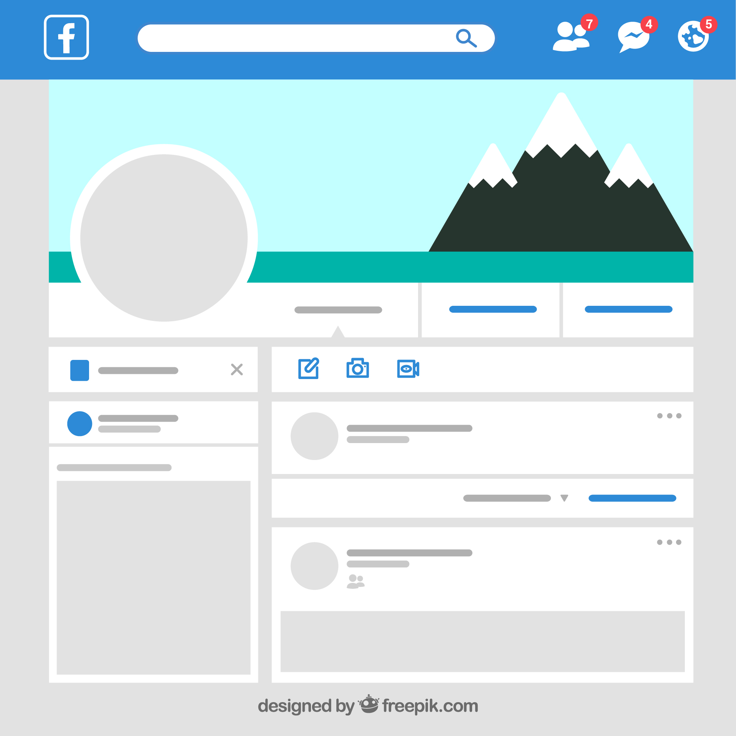
Single Page Application (SPA)
A Single Page Application:
Loads one HTML file
Updates content dynamically
Does NOT reload the entire page.
Examples:
Gmail
Facebook
Netflix
React is commonly used to build SPAs.

Slide 12
Prerequisites Before Learning React
Before starting React, you should understand these core concepts:
HTML and CSS.
Fundamentals of JavaScript and ES6.

Slide 13
Modern Development Environment (2026 Standard)
Required Tools:
Node.js 20+
npm
VS Code
Download Node from: https://nodejs.org

Slide 14

Node and Package Manager (NPM)
Node (or more formally Node.js) is an open-source, cross-platform runtime environment that allows developers to create all kinds of server-side tools and applications in JavaScript.
The runtime is intended for use outside of a browser context (i.e. running directly on a computer or server OS) and can be downloaded the official website of node js https://nodejs.org/en/.

Slide 15

Node and NPM
npm is the package manager for the Node JavaScript platform.
It puts modules in place so that node can find them and manages dependency conflicts intelligently.
NPM is included with Node. js installation.

Slide 16
Dependency or Packages
Dependency is a third-party bit of software that was probably written by someone else and ideally solves a single problem for you.
A web project can have any number of dependencies, ranging from none to many.
A project dependency can be an entire JavaScript library or framework — such as React or Vue.

Slide 17
Package manager
Package manager is a system that will manage your project dependencies.
The package manager will provide a method to install new dependencies (also referred to as "packages"), manage where packages are stored on your file system, and offer capabilities for you to publish your own packages.
Popular package managers include NPM, PNPM & YARN
Notes:
NPM stands for Node package manager
Yarn stands for Yet Another Resource Negotiator
PNPM stands for Performant Node Package Manager

Slide 18

Creating a React Project (Modern Way)
Do NOT use Create React App (deprecated).
Use Vite.
If you've ever felt that create-react-app takes too long to set up or runs a bit slow, you're not alone. That's where Vite comes in.
Vite (French word for "quick", pronounced like "veet") is a tool that allows us to create and run light to mid-sized React applications.

Slide 19
Creating a React Project (Modern Way)
Setting up a React project with Vite is straightforward and efficient:
Step 1: Install Node.js
Step 2: Create the Project:
npm create vite@latest my-react-app
Replace my-react-app with your preferred project name. This will start an interactive setup.
Step 3: Select Framework:
When prompted, choose:
React
Step 4: Choose Variant:
Select either:
JavaScript (React)
TypeScript (React + TS) Choose based on your project requirements.

Slide 20
Creating a React Project (Modern Way)
Step 5: Navigate to Project Folder:
cd my-react-app
Step 6: Install Dependencies:
npm install
This installs all required packages listed in package.json.
Step 7: Start Development Server:
npm run dev
You’ll see output similar to:
Local: http://localhost:5174/
Open this URL in your browser to view your React app running with Vite’s fast Hot Module Replacement (HMR).

Slide 21
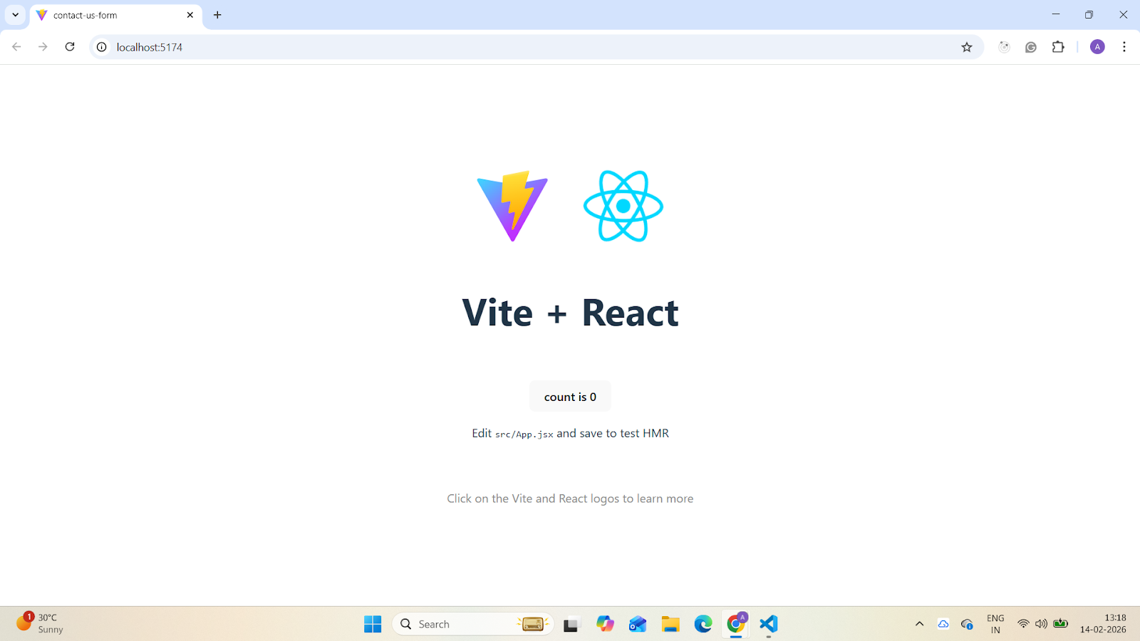

Slide 22
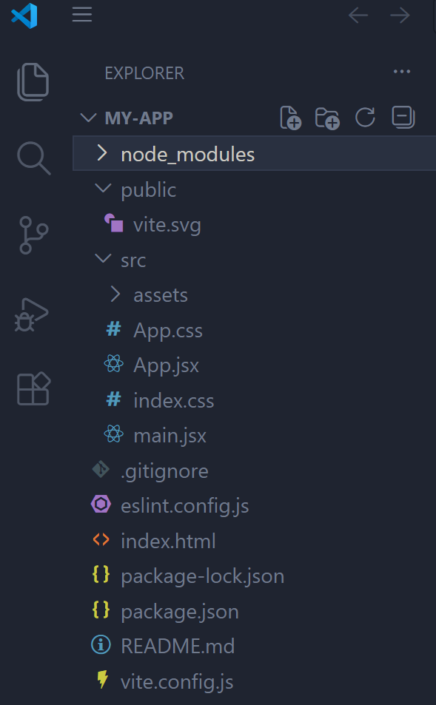
React Project folder structure
This directory contains all the dependencies and packages required for that project.
This directory contains the public assets of the project, like the index.html file
The source code of your React application resides here.
This file displays all files and folders that shouldn’t be added to your git repository when using git, as such files and folders should be located only in your local project.
This file contains metadata about the project and manages project dependencies.

Slide 23
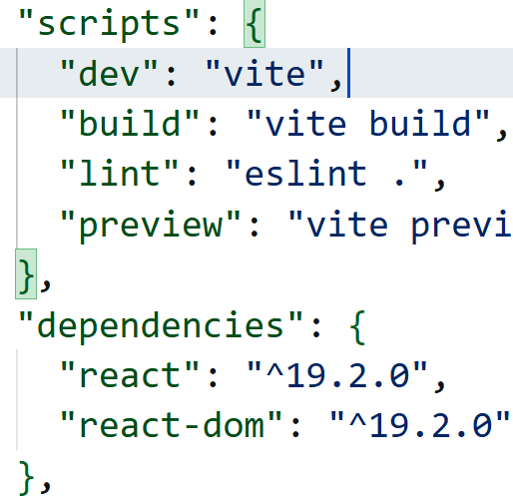
React Project folder structure
All your project-specific commands can be found in your package.json under the scripts property.

Slide 24
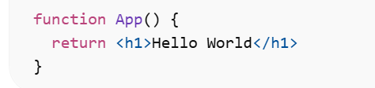
Introduction to JSX
JSX allows us to write HTML elements in JavaScript and place them in the DOM without any createElement() and/or appendChild() methods.
JSX stands for JavaScript XML.
JSX converts HTML tags into react elements.
JSX makes it easier to write and add HTML in React.
Example:

Slide 25
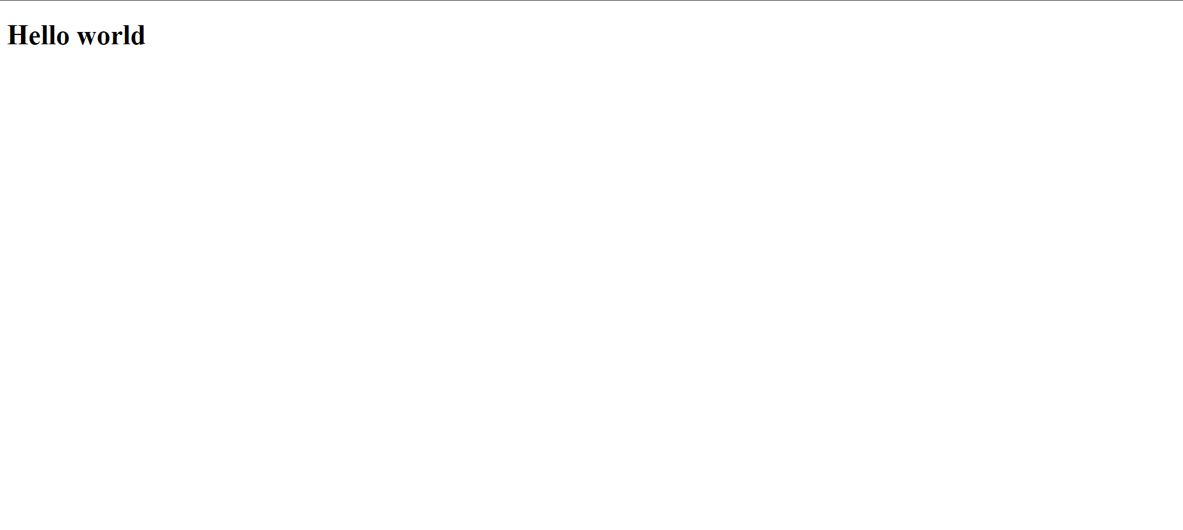
Running a React Project (Vite)
Start the Development Server:
npm run dev
Stop the Development Server:
Ctrl + C
Output

Slide 26
React Components
In React, components are the building blocks of a user interface.
They are reusable, self-contained pieces of code that can be composed together to create complex UIs.
There are two main types of components in React: functional components and class components.
React apps are built using functional components.
Class components are legacy and rarely used in 2026.

Slide 27
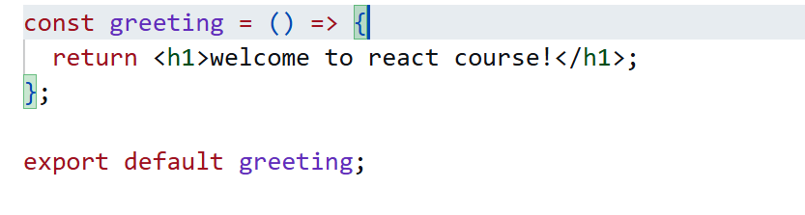
React Components
Functional Components:

Slide 28
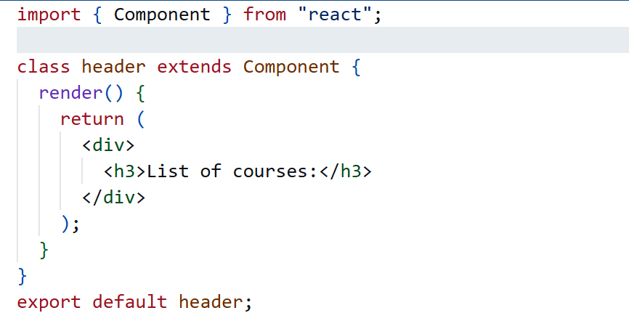
React Components
Class Components:

Slide 29
React Components
In older versions of React, you had to write:
import React from 'react'
This was required because JSX was transformed into:
React.createElement()
Modern React (17+ / 18+ / 2026 Standard):
You do NOT need to import React just to use JSX.
Modern build tools (Vite, Next.js, etc.) use the new JSX transform, which automatically handles this during compilation.
You only import from React when you need specific APIs, such as hooks (import { useState } from 'react’).
In older React versions and when using class components, developers had to write import React, { Component } from 'react'

Slide 30
Dynamic Values & lists in JSX
With JSX you can write expressions, variables inside curly braces { }.
The expression can be a React variable, or property, or any other valid JavaScript expression.
JSX will execute the expression and return the result.

Slide 31
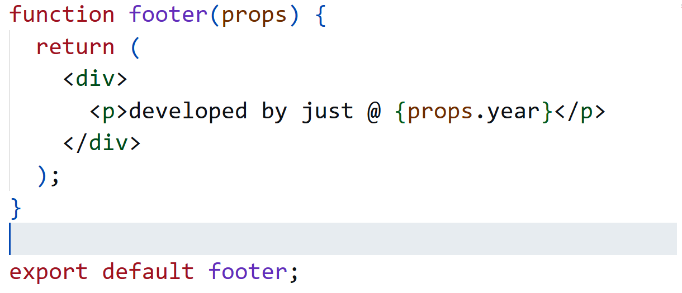
Cont…

Slide 32
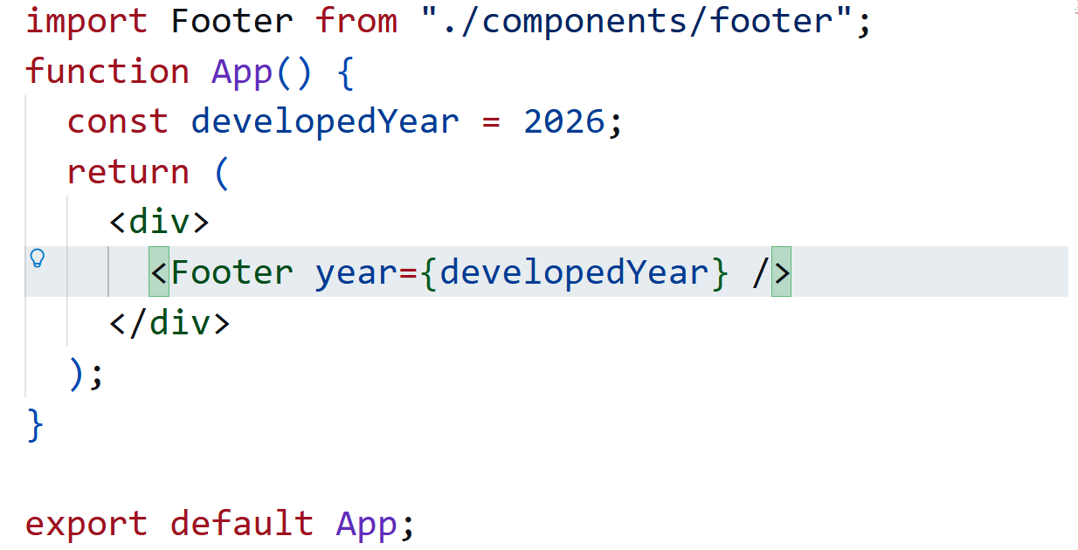
Cont…

Slide 33
Cont…
The App component is a simple functional component that renders an h1 element with a title and a p element with some body text.
The use of variables within JSX allows you to dynamically display content.
You've defined one variable, developedYear, using the const keyword.
Inside the JSX, you use curly braces {} to embed these variables within the HTML-like structure.
The return statement returns the JSX code to be rendered by the component.

Slide 34
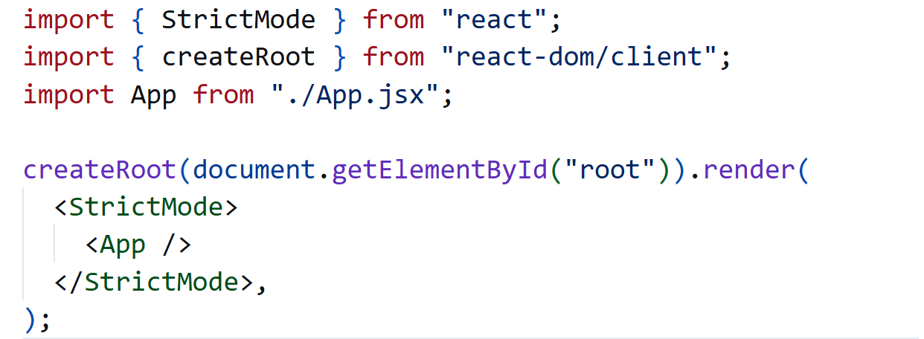
Cont…
When you import and use this App component in your index.js file (as shown in the previous response), it will render an HTML structure with the dynamic content provided by the title and body variables.

Slide 35
Cont…
import App from './App.jsx'; imports the main App component from the same directory.
createRoot() from react-dom/client is the modern React 18+ API used to render the application.
It attaches the App component to the DOM element with the id "root", which is where the React application is mounted in the HTML file.
The <StrictMode> component is a development tool that helps detect potential problems by highlighting unsafe patterns and running additional checks.

Slide 36
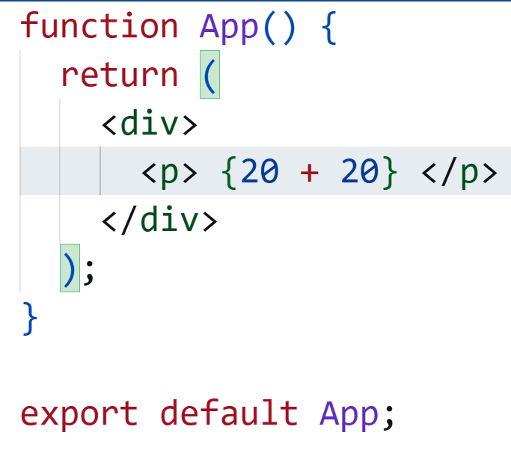
Cont…
We've used curly braces {} to embed the expression 20 + 20 within the JSX.
This allows you to perform JavaScript calculations and display the result directly in your React component.

Slide 37
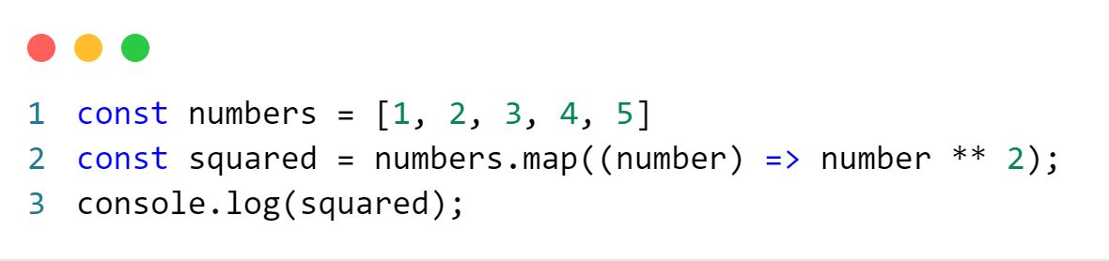
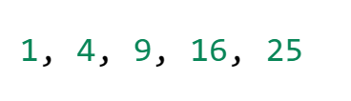
lists in JSX
First, let’s review how you transform lists in JavaScript.
Given the code below, we use the map() function to take an array of numbers and double their values.
We assign the new array returned by map() to the variable squared and log it:
In React, transforming arrays into lists of elements is nearly identical.
You can build collections of elements and include them in JSX using curly braces {}.
output

Slide 38
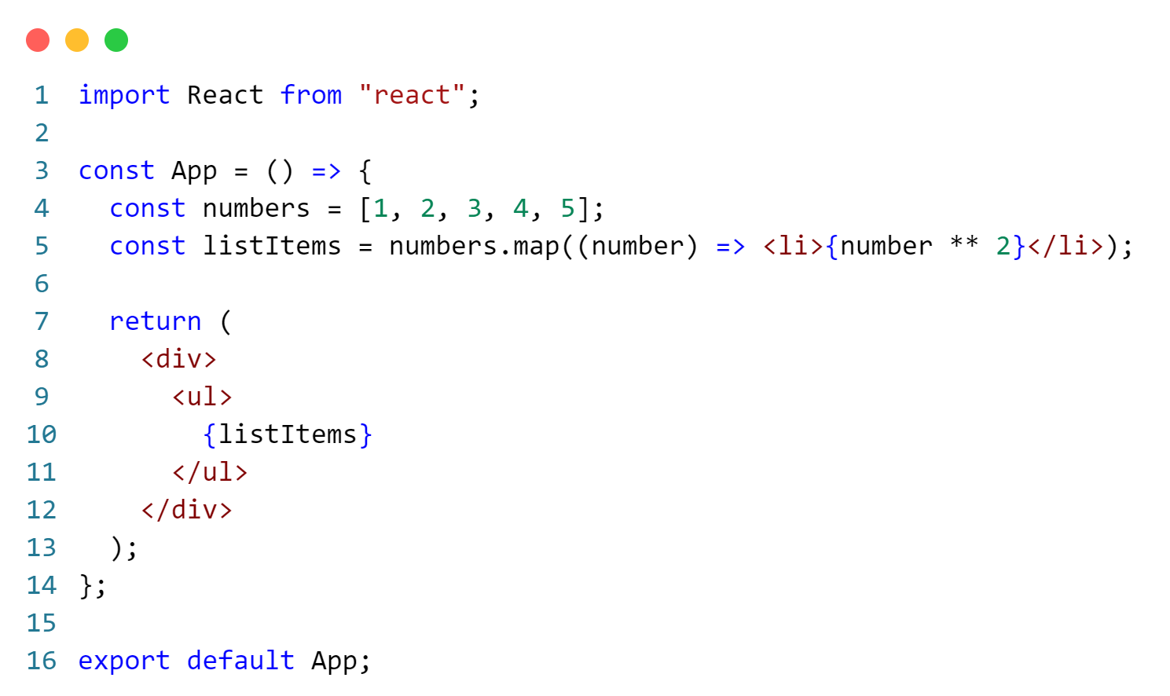
Cont…
We loop through the numbers array using the JavaScript map() function.
We return a <li> element for each item.
Finally, we assign the resulting array of elements to listItems.

Slide 39
Cont…
We've created an array numbers containing [1, 2, 3, 4, 5].
We've used the map function to iterate over each number in the array and created an array of <li> elements with the squared values.
The resulting array of <li> elements is stored in the listItems variable.
Inside the JSX, you've included the {listItems} variable, which will render the array of <li> elements within the <ul> element.
When you run the previous code, you’ll be given a warning that a key should be provided for list items.
A “key” is a special string attribute you need to include when creating lists of elements. We’ll discuss why it’s important in the next section.
Let’s assign a key to our list items inside numbers.map() and fix the missing key issue.

Slide 40
Conditionals in JSX
In React, you can create distinct components that encapsulate behavior you need. Then, you can render only some of them, depending on the state of your application.
Conditional rendering in React works the same way conditions work in JavaScript.
Use JavaScript operators like if or the conditional operator to create elements representing the current state and let React update the UI to match them.
Conditional rendering in React means displaying different UI elements based on a condition (like state, props, or user actions).

Slide 41
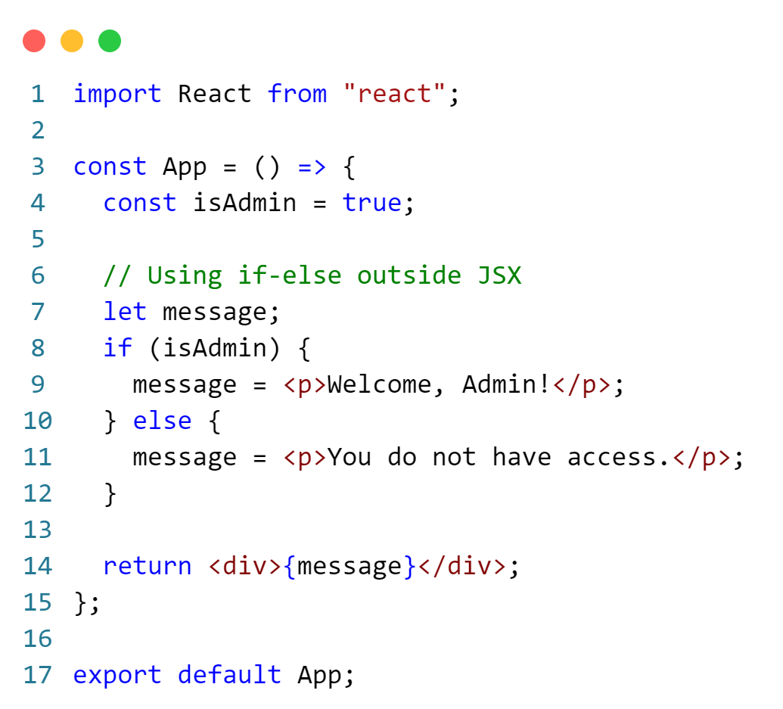
Using If-Else Statements (Outside JSX)
Conditionals in JSX can be achieved using JavaScript expressions and statements within curly braces {}.
In this example, an if-else statement is used outside JSX to conditionally assign a value to the message variable.
This approach is best when:
The logic is complex
You need multiple return cases
You want clean and readable code

Slide 42
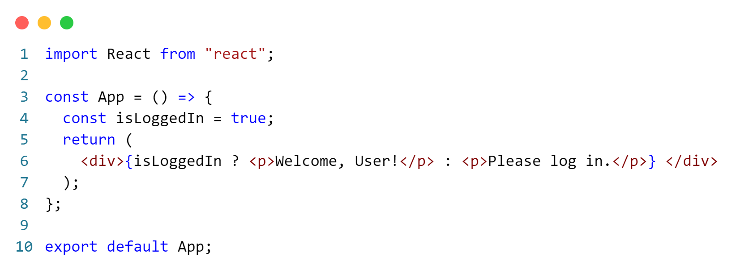
Using the Ternary Operator
In this example, the ternary operator (condition ? trueValue : falseValue) is used to conditionally render different JSX based on the value of isLoggedIn.

Slide 43
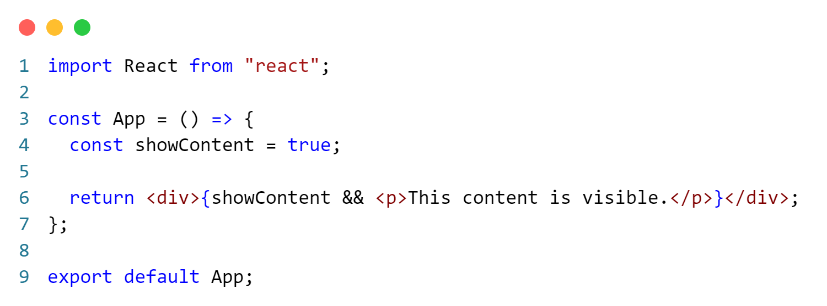
Using && Logical Operator
Here, the && logical operator is used to conditionally render the JSX if showContent is true.

Slide 44
React Props
Props stand for "Properties." They are readonly components.
It is an object which stores the value of attributes of a tag and work like the HTML attributes.
It gives a way to pass data from one component to other components.
Props are passed to the component in the same way as arguments passed in a function.
Props are a mechanism for passing data from a parent component to a
child component.
Props allow you to customize and configure child components by passing values to them.

Slide 45
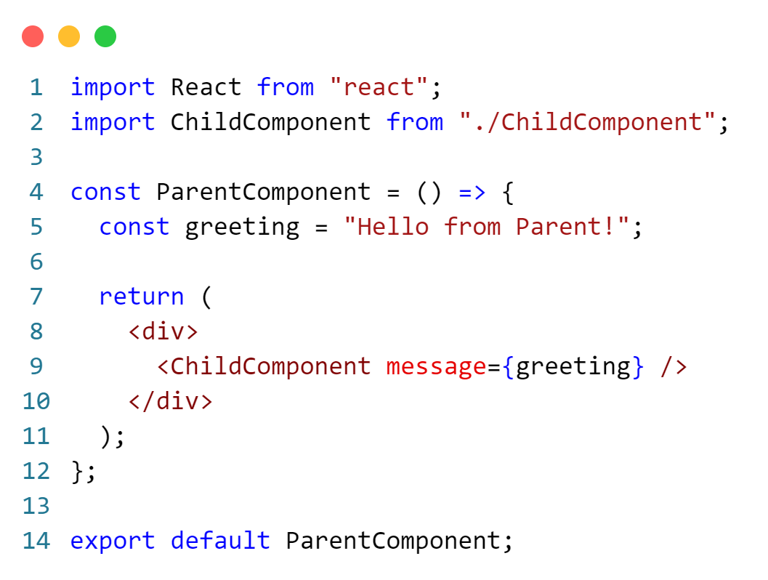
Passing Props from Parent to Child Component

Slide 46
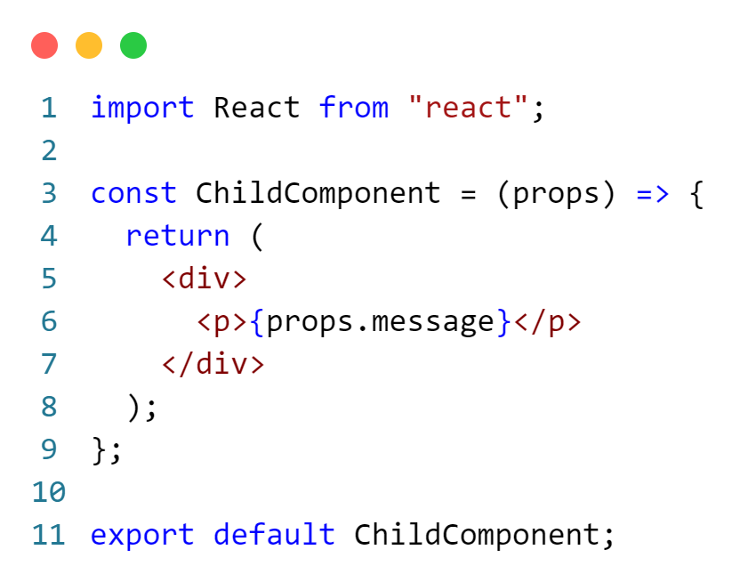
Passing Props from Parent to Child Component

Slide 47
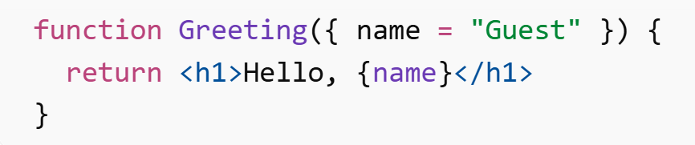
Default props
Default props are used to provide fallback values when a prop is not passed to a component.
In 2026, the recommended way is to use default parameters in function arguments:
If name is not provided, it automatically defaults to "Guest".

Slide 48
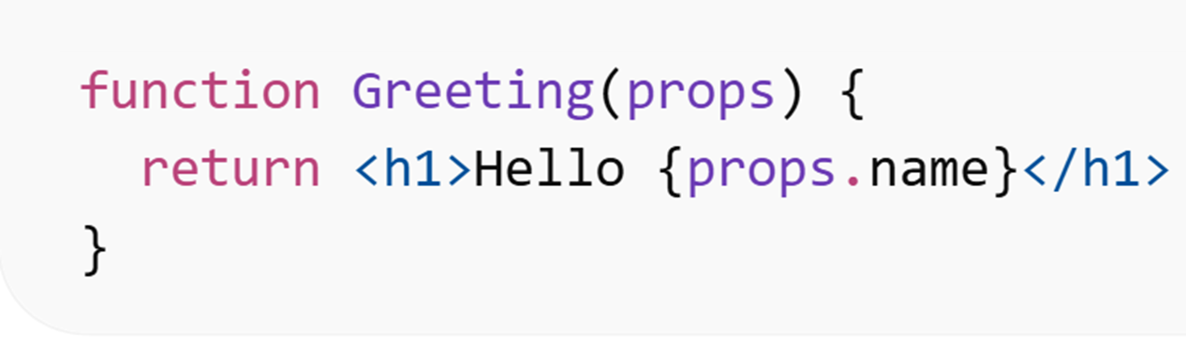
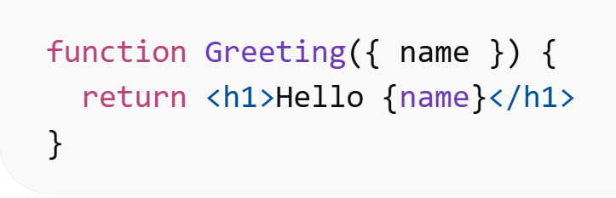
Destructuring Props
Destructuring props is a modern JavaScript technique used to extract values directly from the props object for cleaner and more readable code.
Without Destructuring | With Destructuring (Recommended)
Why Use Destructuring?
Cleaner syntax.
Less repetitive code.
Easier to read and maintain.
Standard practice in modern React.
In 2026, destructuring props in the function parameter is the recommended approach.

Slide 49
END

